Slide 1
Tackling The Opioid Crisis Through Data
“Anyone who takes opioids is at risk of developing addiction. Your personal history and the length of time you use opioids play a role, but it's impossible to predict who's vulnerable to eventual dependence on and abuse of these drugs. Legal or illegal, stolen and shared, these drugs are responsible for the majority of overdose deaths in the U.S. today.”
-Mayo Clinic, How Opioid Addiction Occurs
By Team Git ‘Er Done Chelsea Monahan, Jason Winer, Holly Bergen, Robert Sayler

Slide 2
Questions
Does the rate of opioid prescriptions per 100,000 people in a county affect the opioid overdose death rate?
Does the education level in a county affect the rate of opioid prescriptions?
Did unemployment rates during the Great Recession affect current overdose rates?
Null Hypothesis
Opioid addiction is random and is not affected by prescription rates, education level, or unemployment during the Great Recession
Notes:
What motivated us to answer these?

Slide 3
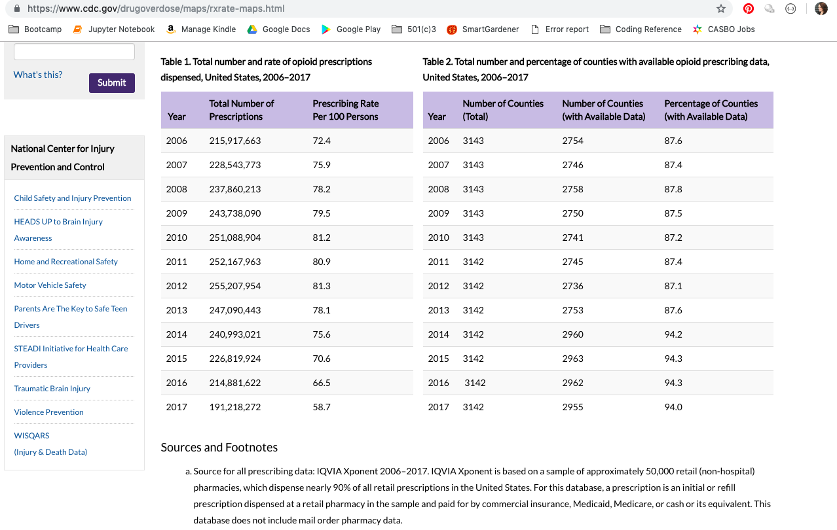
Data Sets & References
Census API
Center for Disease Control (CDC ) Opioid Overdose Data
Bureau of Labor Statistics
Kaiser Family Foundation in partnership with the CDC
Hold for screenshot of data/website

Slide 4
Code (INSERT JUPYTER NOTEBOOK SCREENSHOT)

Slide 5
Overview of Opioid Deaths by County (Jason)

Slide 6
Overview of Opioid Deaths by County (Jason)

Slide 7
Results
Analysis

Slide 8
Does the opioid prescribing rate affect the opioid overdose death rate? (Holly)
Data sources
CDC Opioid Prescription Data
CDC Death Data
Challenges
Process

Slide 9
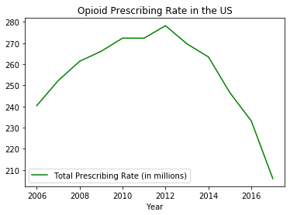
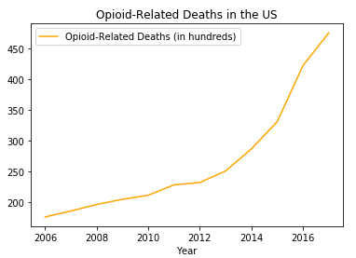
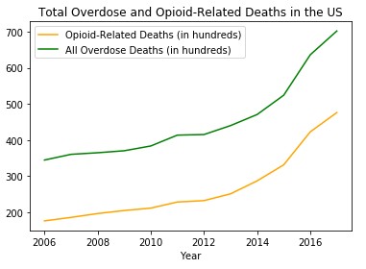
Questions 1&2 (Holly)
Does the opioid prescribing rate affect the opioid overdose death rate? (Holly)

Slide 10
Results
Limitations
Multiple possibilities:
No correlation between prescribing rate and opioid-related deaths
Prescriptions become a gateway to addiction and then addicts go underground
Rate of actual addiction is also under-represented in the data, and difficult to track use of illicit opioids if they did not lead to death
Not all opioid-related deaths are tracked, so data is likely well under-represented
Looking at deaths alone does not account for opioid-related hospitalizations and overdoses

Slide 11
Does the education level in a county affect the rate of opioid prescriptions?
Data sources
Census API
CDC Opioid Prescription Data
Challenges
Pulling data for all counties (not just those over 65,000 residents)
Had to pull over 40 different variables to get the (seemingly) simple info needed
County data not automatically pulled with FIPS code
Process
Pulled data from API & created dataframe with clear labeling
Merged, processed, and ran calculations on data to create appropriate columns in dataframe
Merged State and County data to create FIPS codes
Merged dataframe with CDC csv
Weighted education level percentages and found totals for each county
Created coropleth maps using Plotly
Created scatterplot and ran regression

Slide 12
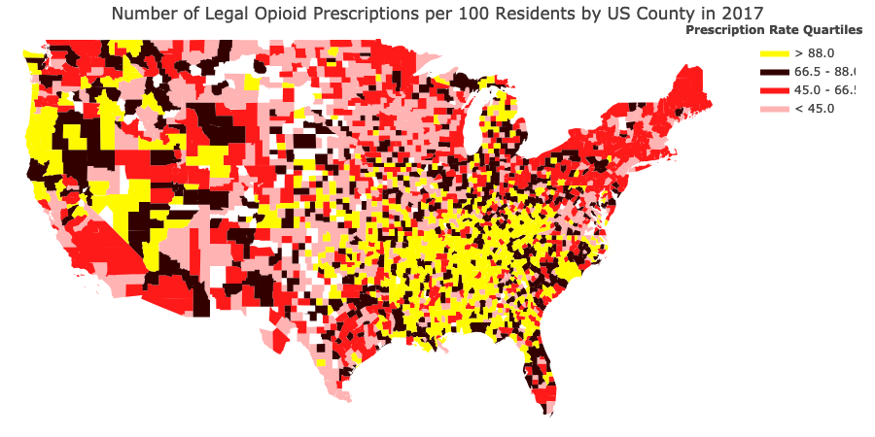
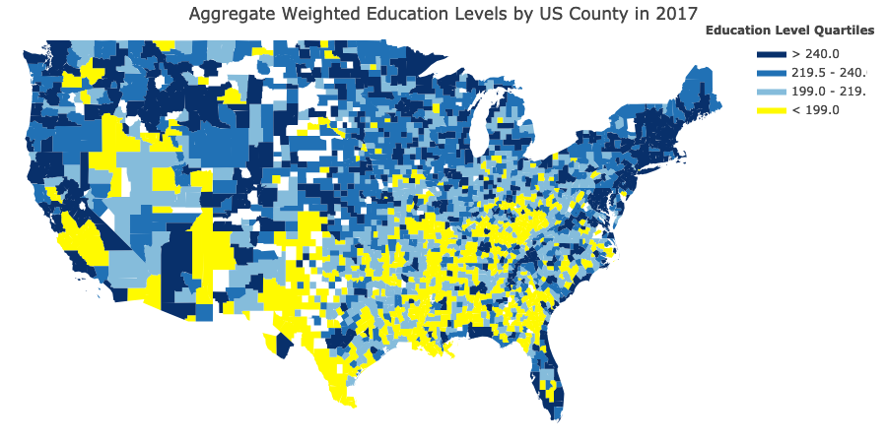
Does the education level in a county affect the rate of opioid prescriptions?
Counties in yellow had the highest opioid prescription rates in the country (top 25%)
Counties in Yellow had the lowest education levels in the country (bottom 25%)
Notes:
Click each map to open interactive maps online

Slide 13
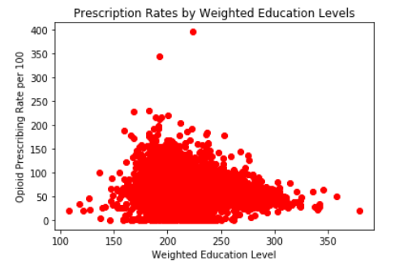
Results
Limitations
Methodology for determining education weights could be improved
Analysis
Regression Statistics
Multiple R | 0.15448049
R Square | 0.02386422
Adjusted R Square | 0.02353288
Standard Error | 36.1085484
Observations | 2948
There is absolutely no correlation between education levels and opioid prescription rates

Slide 14
Did unemployment rates during the Great Recession affect current overdose rates? (Robert)

Slide 15
Did unemployment rates during the Great Recession affect current overdose rates? (Robert)

Slide 16
Results
Analysis

Slide 17
CONCLUSIONS
Q: Does the rate of opioid prescriptions per 100,000 people in a county affect the opioid overdose death rate?
A: YES
Q: Does the education level in a county affect the rate of opioid prescriptions?
A: NO
Q: Did unemployment rates during the Great Recession affect current overdose rates?
A: TBD

Slide 18
Parting Words…
“One study, published in the Journal of the American College of Surgeons in February 2018, noted that one in 16 surgical patients prescribed opioids becomes a long-term user” - https://www.clinicalkey.com/info/blog/opioid-prescribing-rates-drop-in-wake-of-cdc-guidelines/

